Slide 1
Grand Canonical Ensemble
~The Quiz
By Arnav and Subham

Slide 2
PRELIMS
RULES
The prelims will have 12 questions.
Written Round.
Answers will be shown at the end.
The teams with the most questions answered will progress to the next round.
Star marked questions will serve as tiebreakers.

Slide 3
1
In Longyearbyen, Norway, the burial of dead bodies has been prohibited since 1950 it was discovered that live strains of the 1918 Spanish flu virus could still be present in the bodies of those who succumbed to the flu. Why was this decree passed?

Slide 4
2*
The world’s longest continuously running experiment was started in 1927 by Professor Thomas Parnell of the University of Queensland in Brisbane, Australia, to break the misconception related to glass-like substances. This misconception arose due to the way window panes were installed in old Churches and cathedrals.
The experiment repeats itself roughly once every decade, and has since been housed in a glass jar with a live stream.
The substance has traditionally been used for waterproofing ships, and gives rise to the phrase_ _ _ _ _ - _ _ _ _ _, which links the substance to its most apparent characteristic.
What is the substance, and what is the setup of the experiment?

Slide 5
3
“If none of the works under consideration is found to be of the importance indicated in the first paragraph, the prize money shall be reserved until the following year. If, even then, the prize cannot be awarded, the amount shall be added to the Foundation’s restricted funds.”
This is the official statement in the statutes of the Nobel Foundation stating when a prize would not be awarded.
Following lists the years when the Nobel Prize was not awarded in academic
disciplines
Physics: 1916, 1931, 1934, 1940, 1941, 1942
Chemistry: 1916, 1917, 1919, 1924, 1933, 1940, 1941, 1942
Physiology or medicine: 1915, 1916, 1917, 1918, 1921, 1925, 1940, 1941, 1942
Literature: 1914, 1918, 1935, 1940, 1941, 1942, 1943
Economics Prize is the only prize that has been awarded on every single occasion.
What could be the reason for this exception?

Slide 6
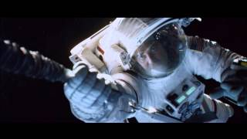
4
What is wrong with this scene?

Slide 7
5*
_____ was originally conceived and developed to for automatic information-sharing between scientists in universities and institutes around the world working in collaboration with CERN.
The basic idea was to help develop a global information system.
What is being talked about here?

Slide 8
6
Albert Einstein was born on 14th March 1888(14/03/1888) in Ulm, Germany. However, contrary to what one would expect 14th March is not celebrated as “Einstein Day” or something similar along the lines, but as “___-Day”.
FITB.

Slide 9
7
“First of all, I’m an atheist. The second thing is I know that name was a kind of joke and not a very good one. I think he shouldn’t have done that as it’s so misleading.”
The speaker refers to a Nobel prize theoretical physicist’s book that popularized the term. What is being talked about here?

Slide 10
8*
In 1968, Dr. Spencer Silver, a scientist at 3M in the United States, attempted to develop a super-strong adhesive. Instead, he accidentally created a "low-tack", reusable, pressure-sensitive adhesive. For five years, Silver promoted his "solution without a problem" within 3M both informally and through seminars, but failed to gain adherents. In 1974, a colleague who had attended one of his seminars, Art Fry, came up with the idea of using the adhesive to anchor his bookmark in his hymn book.
This revolutionary idea sparked a worldwide household product. Identify it.

Slide 11
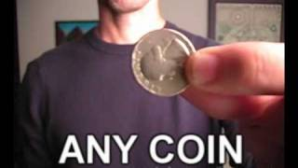
9
Why doesn’t the coin fall off? (Give a complete explanation)

Slide 12
10*
“Tiny charged particles act as nuclei for condensation of polar molecules like water and alcohol. Water/alcohol vapors being polar are attracted towards the nuclei where they coalesce and condense forming _______”
This principle is used in an experimental device that has been used in the forefront of research ever since, leading to several Nobel prizes.
Identify the device and its contribution to Nobel-worthy discoveries.

Slide 13
1. The permafrost prevents the body from decomposing

Slide 14
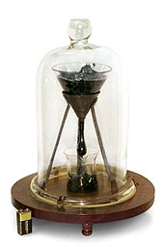
2. The pitch drop experiment

Slide 15
3. Economics Prize was introduced in 1968 after the world wars.

Slide 16
4. the only forces acting upon Bullock and Clooney should be the tensions of the cables, and these forces should pull them towards the station (making them bounce at first and then becoming zero as the cables retract). In the movie, however, there appears to be another force pulling from Clooney, keeping the cables straight and threatening to break them.

Slide 17
5. World Wide Web

Slide 18
6. International π-Day

Slide 19
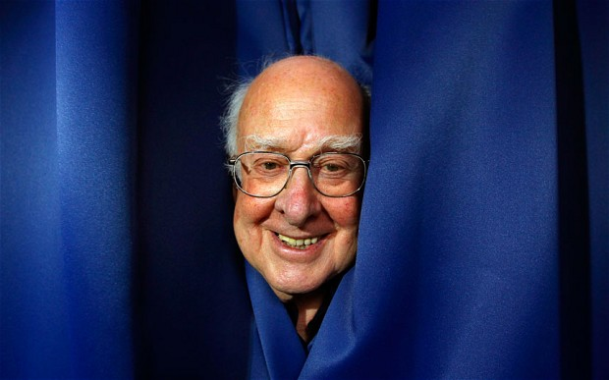
7. The God Particle/Higgs Boson

Slide 20
8.Post-Its

Slide 21
9. Hanger provides necessary centripetal force to the coin throughout the motion maintaining the circular trajectory.

Slide 22
10. Cloud Chambers- Discovery of charged subatomic particles

Slide 23
RULES
This quiz will have 5 rounds.
IB Forward → 9 Questions
Booster Connect → 4 Questions
ID the Patent → 5 Questions
Booster → 3 Questions
IB Reverse → 10 Questions
Points System and Rules will be specified prior to every round.
Quizmasters’ decision is final.

Slide 24
ROUND 1
IB FORWARD
● Infinite Bounce (+10/0) - First question directed to Team 1 -bouncing forwards. 10 points for correct answer, no negatives - Feel free to take guesses.
● Pounce (+10/-5) - Pounce should have the full answer. No part pouncing, unless otherwise specified. 10 points for correct answer, -5 for wrong/incomplete answer.
● Directed to the team following the team which answered previously.

Slide 25
1
John Bardeen’s second Nobel Prize in Physics in 1972 for the development of superconductor theory made him a first in something. In 2022, K. Barry Sharpless became only the third person ever to achieve this feat.
What is being talked about here?

Slide 26
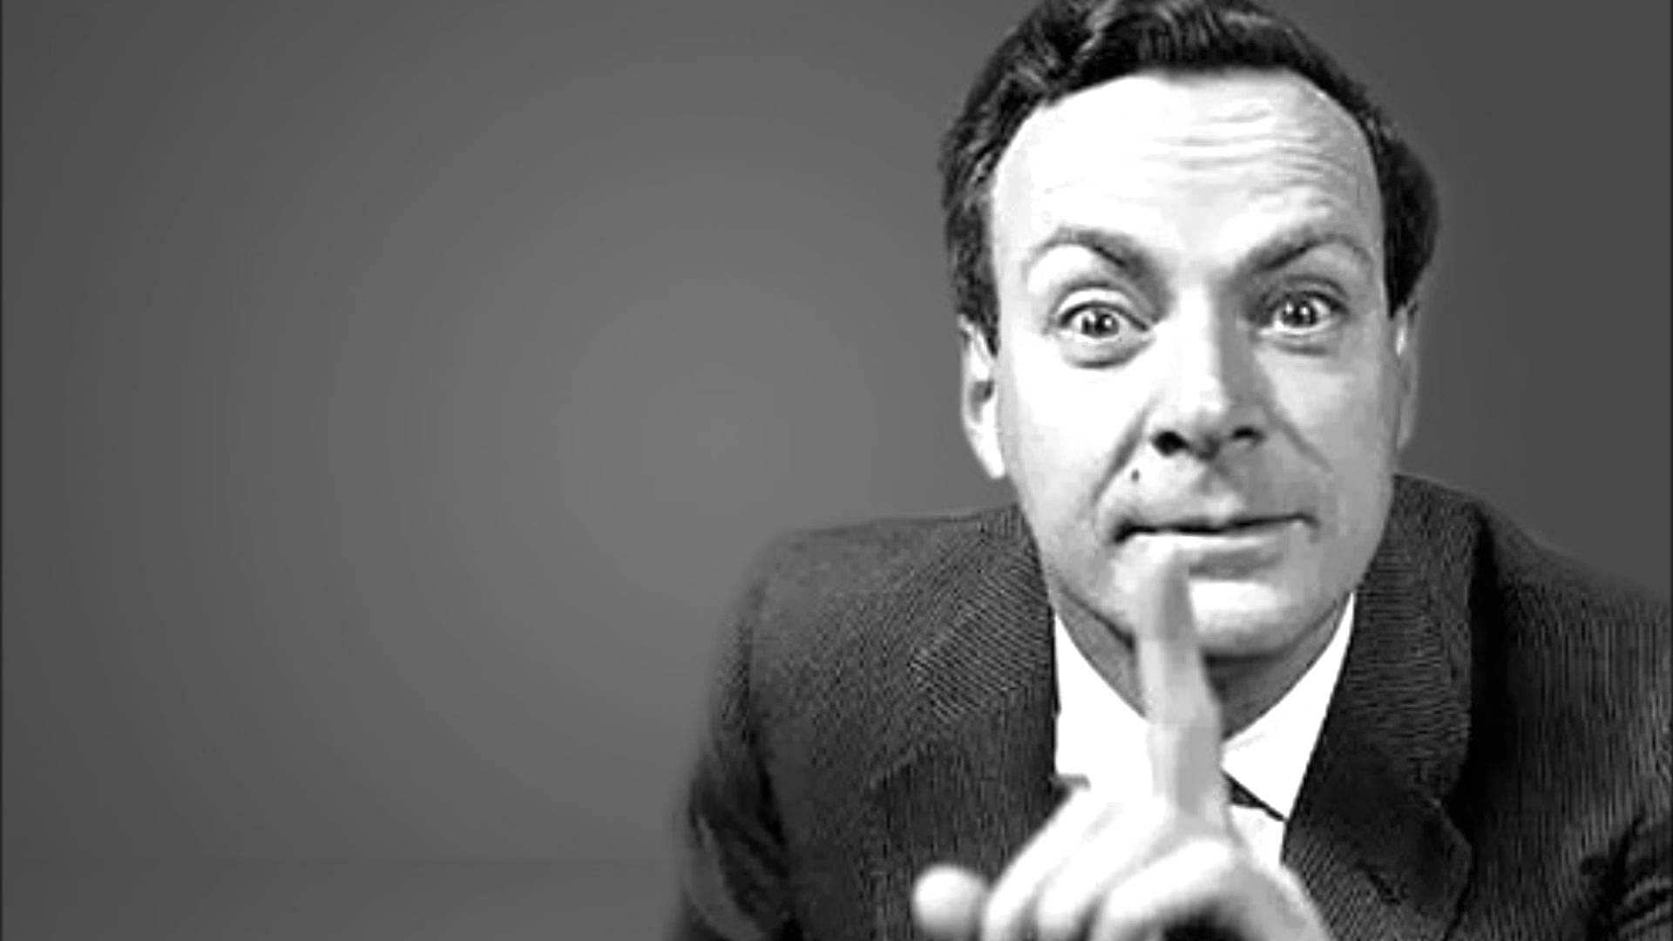
SAFETY SLIDE

Slide 27
Double Laureates in the same academic category.

Slide 28
2
Van Goethe’s poems praising Luke Howard for his achievements.
“To find yourself in the infinite,
You must distinguish and then combine;
Therefore my winged song thanks
The man who distinguished cloud from cloud.”
“bestowing form on the formless, and a system of
ordered change in a boundless world”
What was Luke Howard’s contribution being praised about here?

Slide 29
SAFETY SLIDE

Slide 30
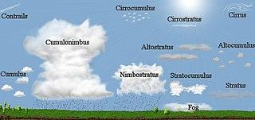
Classification system for clouds

Slide 31

3
The album cover for Unknown pleasure by Joy Division was inspired by the first signal data from a _ _ _ _ _ _(6). Martin Hannett used looping technology for the album which involves pulsating short sections to create ostinato patterns. FITB.

Slide 32
SAFETY SLIDE

Slide 33
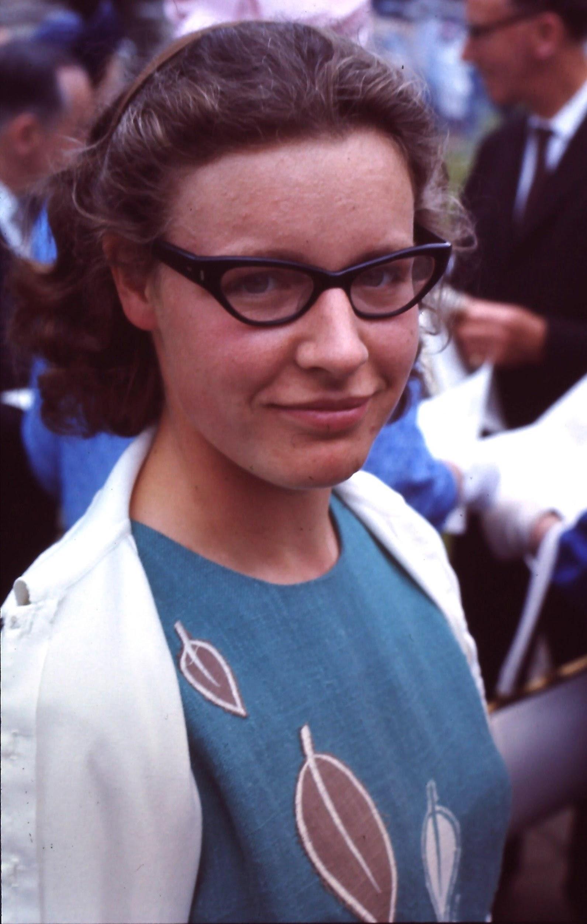
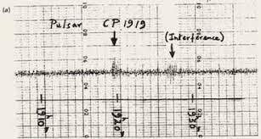
Pulsar
Jocelyn Bell’s Pulsar data.

Slide 34

4
What is being referred to in this music video?

Slide 35
SAFETY SLIDE

Slide 36
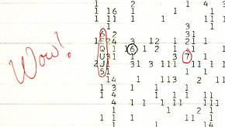
The ‘WOW’ signal

Slide 37
5
The 6eV mass particle was named “Upsilon” by a team at Fermilab led by Leon Lederman that discovered it in January 1976, however, the group discovered that this particle actually did not exist as the data was not convincing. The result would not have been published as per currently accepted standards. The “discovery” was panned as ____ to signify the false alarm.
FITB and give the widely accepted standard in research that would have prevented this result from being published.

Slide 38
SAFETY SLIDE

Slide 39
Oops-Leon
6σ rule

Slide 40
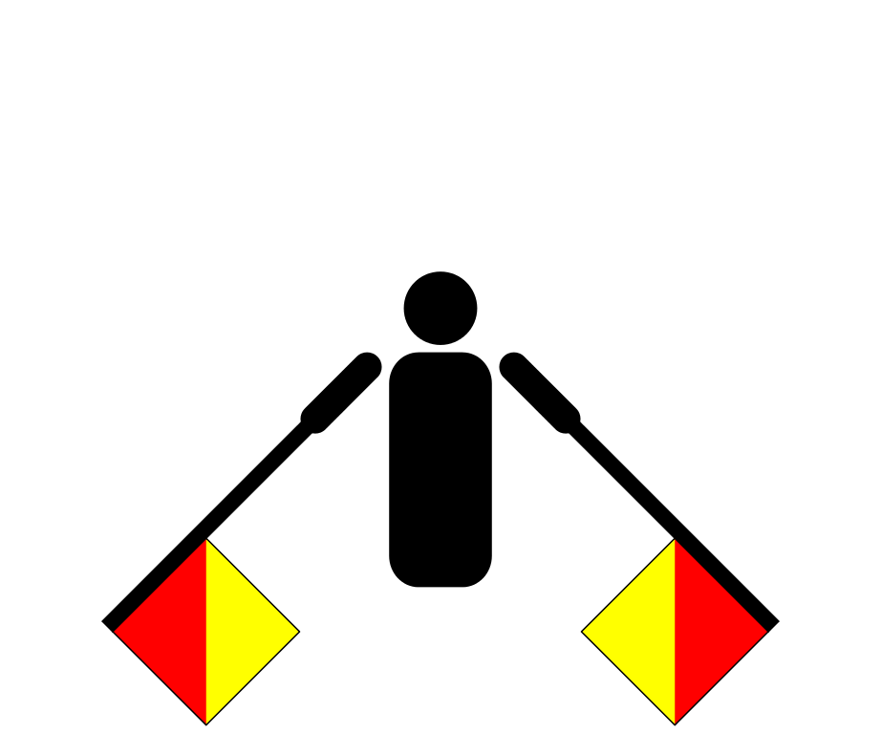
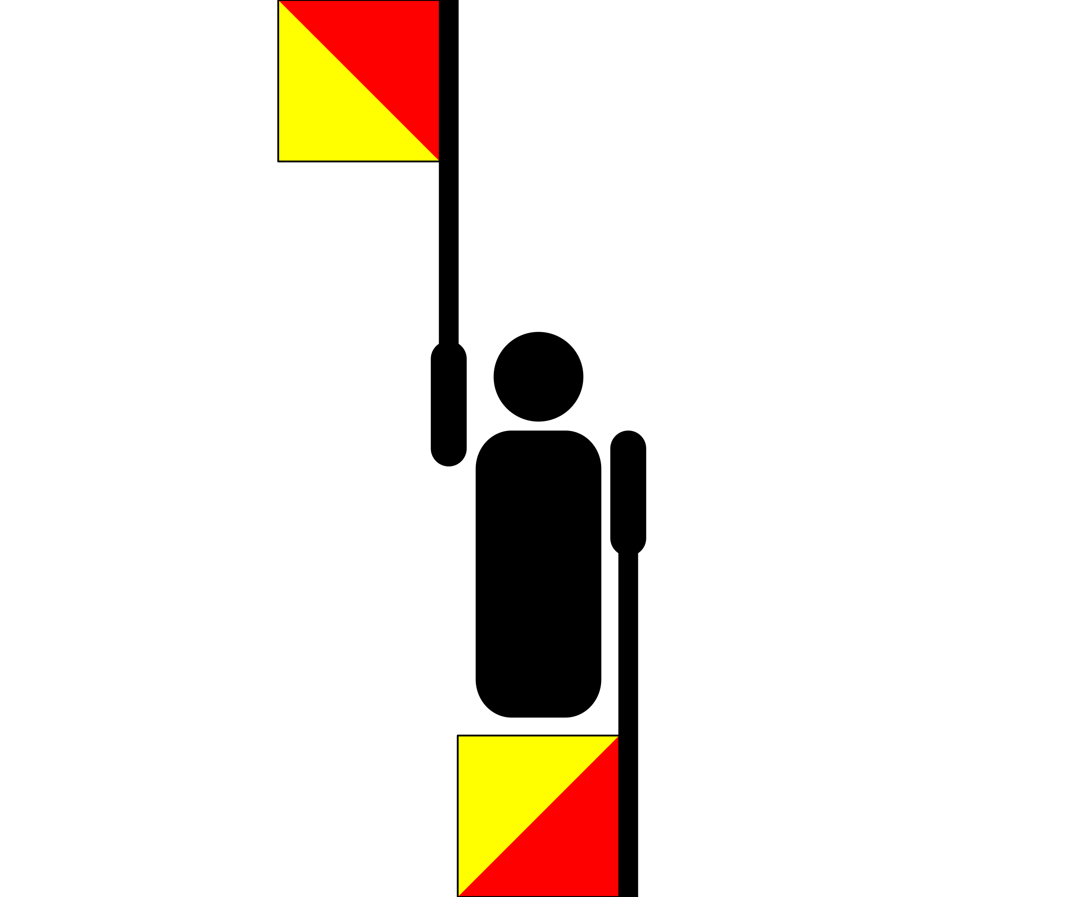
6
The ______ owes its existence to the Nuclear Disarmament Campaign. The _____ was designed by Gerald Holtom for the British Campaign for Nuclear Disarmament in 1958. He used the semaphore signals for ‘N’ and ‘D’ standing for Nuclear Disarmament for the design.
FITB.

Slide 41
SAFETY SLIDE

Slide 42

Peace sign

Slide 43
7
In 1975, Jack Hetherington wanted to publish some of his research results in the scientific journal Physical Review Letters. A colleague pointed out that Hetherington had used the first person plural in his text, and that the journal would reject this form on submissions with a sole author. Instead of re-typing the article, he turned to Chester, a close companion, to be the co-author.
Since Chester only went by his first name, Jack decided to include Chester’s formal designation as well and is thus stated as F.D.C. Willard.
Chester’s collaboration shot the paper into fame, and in 2014 the APS stated that all papers published by Chester-like researchers would be made open source. What makes Chester so special?

Slide 44
SAFETY SLIDE

Slide 45
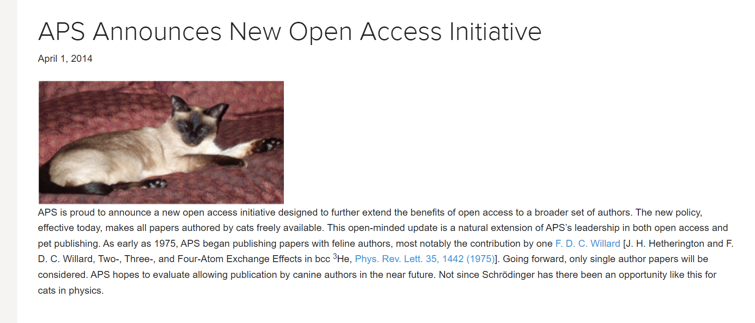

Slide 46
Chester is a cat.

Slide 47
8
Around July 1945, Kodak received numerous complaints from its customers about the appearance of dark spots on unopened X-ray films that damaged the product. This was strange because Kodak had taken necessary steps to prevent its X-ray films from getting exposed to radiation (primarily alpha-particles) from a substance in common use in the US during the second World War.
Why did Kodak have to take measures for radiation protection in the first place? Give the substance being talked about here.

Slide 48
SAFETY SLIDE

Slide 49
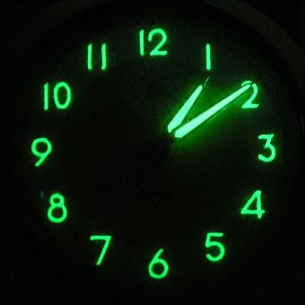
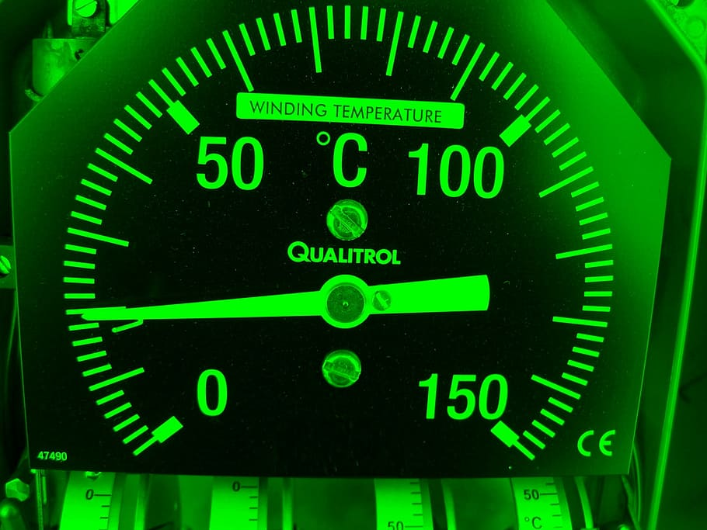
Radium Paint

Slide 50
9
The Mars Climate Orbiter was launched by NASA on December 1998, but they soon lost contact with the probe in September 1999. An investigation revealed the cause of failure to be a conversion error in a sensor provided by the US aerospace company Lockheed Martin.
What was the error?

Slide 51
SAFETY SLIDE

Slide 52
The software that calculated the total impulse produced by thruster firings produced results in pound-force seconds, instead of Newton-force seconds

Slide 53
ROUND 2
BOOSTER CONNECT
● Pounce Only(+10/-5) - Pounce should have the full answer. No part pouncing, unless otherwise specified. 10 points for correct answer.
● All the answers contribute as clues for the last question.
Bonus points will be awarded at the end of the round as follows:-
No. of Questions answered(excluding the last question)x10
*Bonus will only be awarded if the last question is answered correctly.

Slide 54
10
Two-thirds of the 2020 Nobel Prize in Physics was awarded jointly to Andrea GHez and Reinhard Genzel,
“for the discovery of a supermassive compact object at the center of our galaxy”.
Both of their works include working with X which is famously known for producing a first-of-its-kind image in 2019. On 12 May 2022, an image of Sagittarius A* was released making it only the second such image ever produced.
ID X.

Slide 55
SAFETY SLIDE

Slide 56
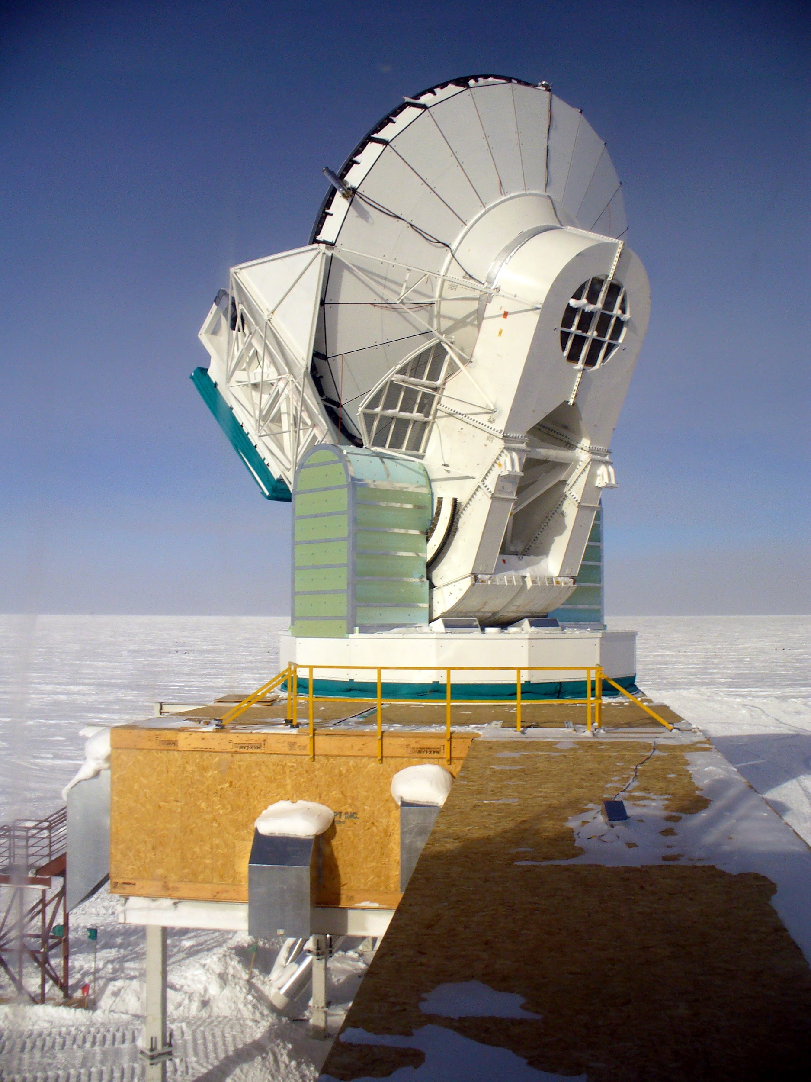
Event Horizon Telescope(EHT)

Slide 57
11
Ultraviolet(UV) radiation is further divided into UVA, UVB, and UVC based on their wavelengths. UVB having just the right energy, is the primary cause of skin cancer in humans.
The Dobson spectrometer operates by measuring the relative intensity of the UVB radiation that reaches the Earth and comparing it to that of UVA radiation at ground level.
The Dobson spectrometer is thus used for the indirect measurement of _ _ _ _ _(5) in the atmosphere.
FITB

Slide 58
SAFETY SLIDE

Slide 59
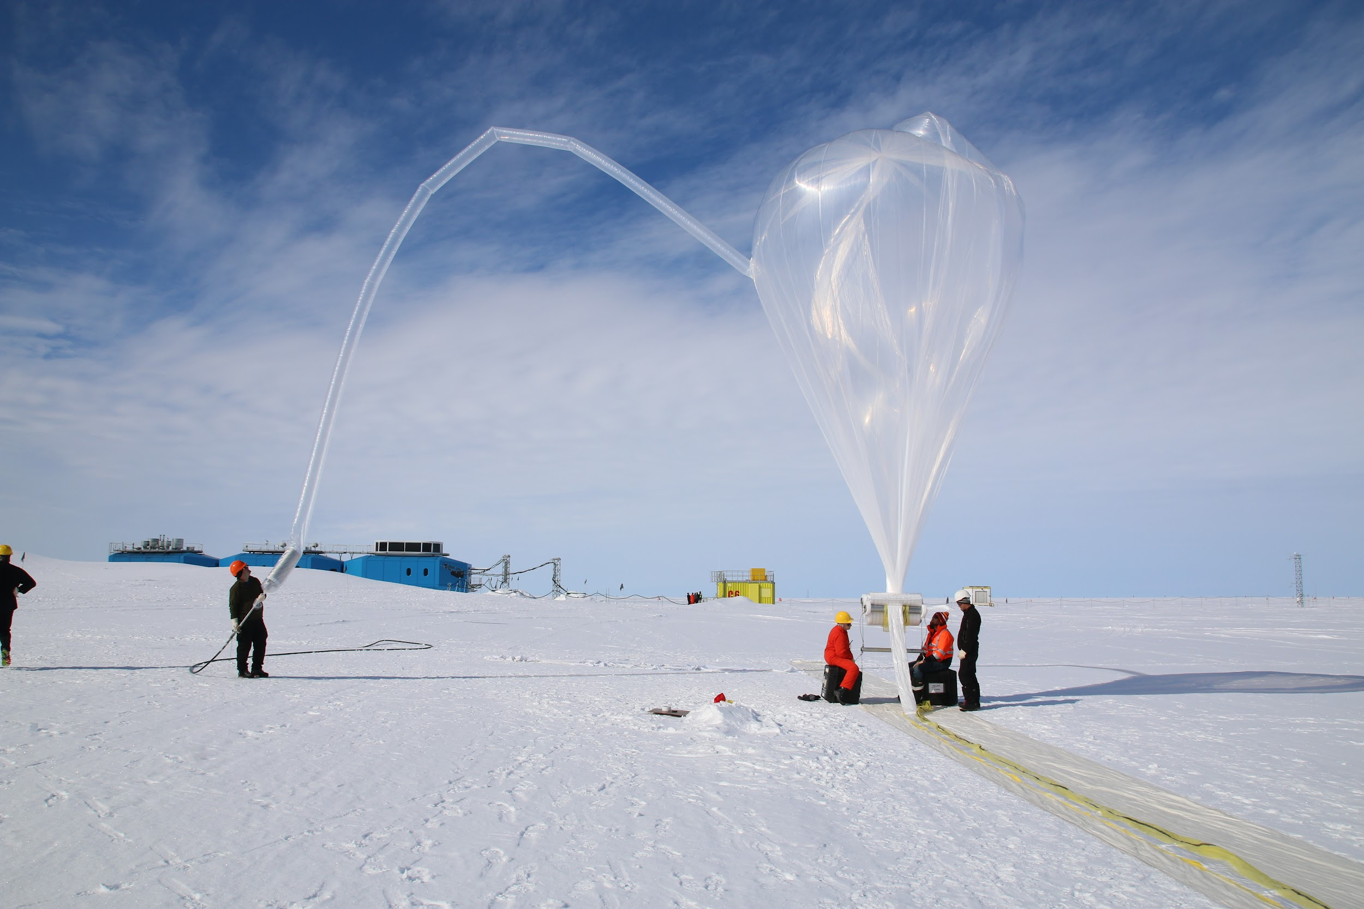
Ozone

Slide 60
12
ICESat-(Ice, Cloud, and land Elevation Satellite) provided loads of data on X, cloud, and aerosol heights, as well as land topography and vegetation characteristics throughout its duration of operation. Data on X has been often linked to climate change and used by climate change advocates to “alarm” people about its consequences.
ID X.

Slide 61
SAFETY SLIDE

Slide 62


Ice sheet mass balance

Slide 63
13
The 250th anniversary of the first documented crossing of the _____ is being marked with a new book that traces its history via 100 artifacts from around the world.
*Images in the answers to the previous slides were some of the objects used in the book.
FITB.

Slide 64
SAFETY SLIDE

Slide 65
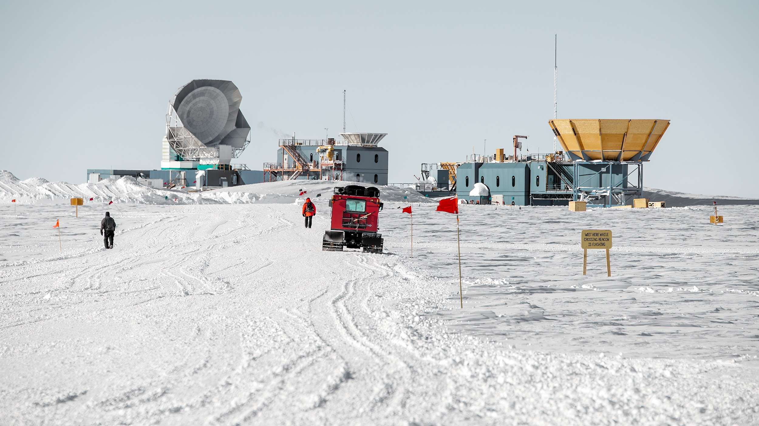
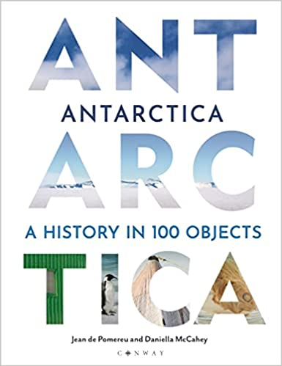
Antarctica

Slide 66
ROUND 3
ID THE PATENT
● This is a written round (+10,0)
Five questions
Full points will only be awarded for stating the exact purpose/motive of the patent.

Slide 67
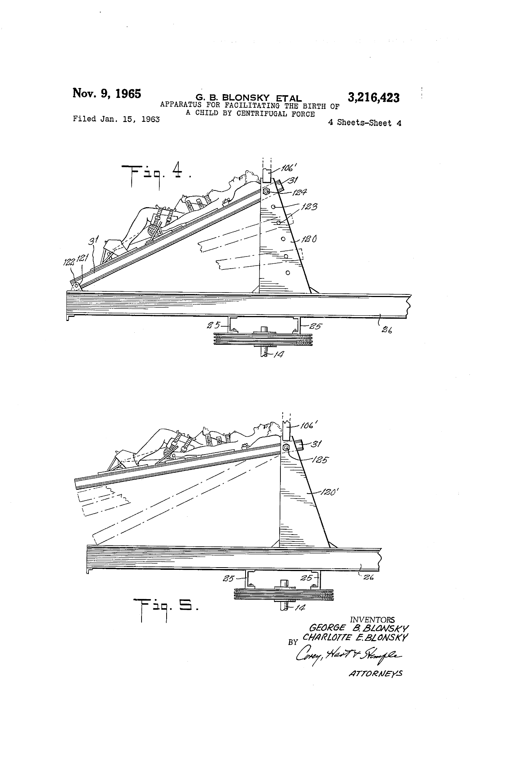
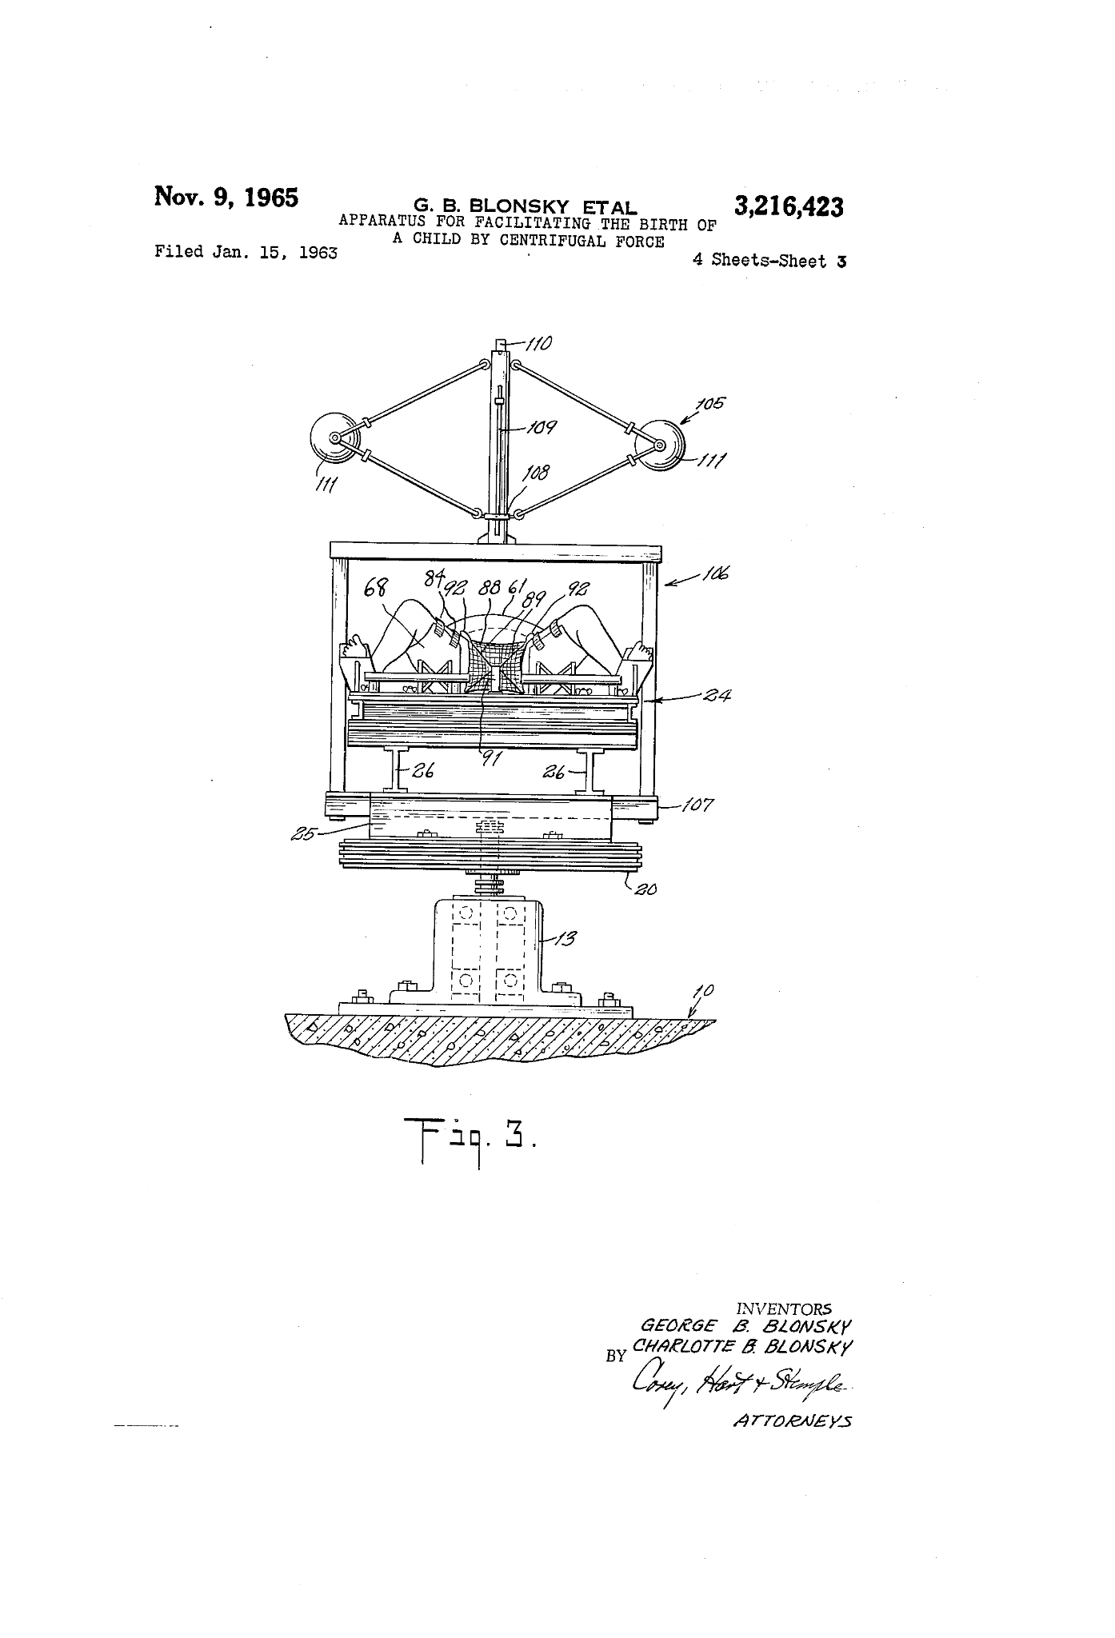
14.

Slide 68
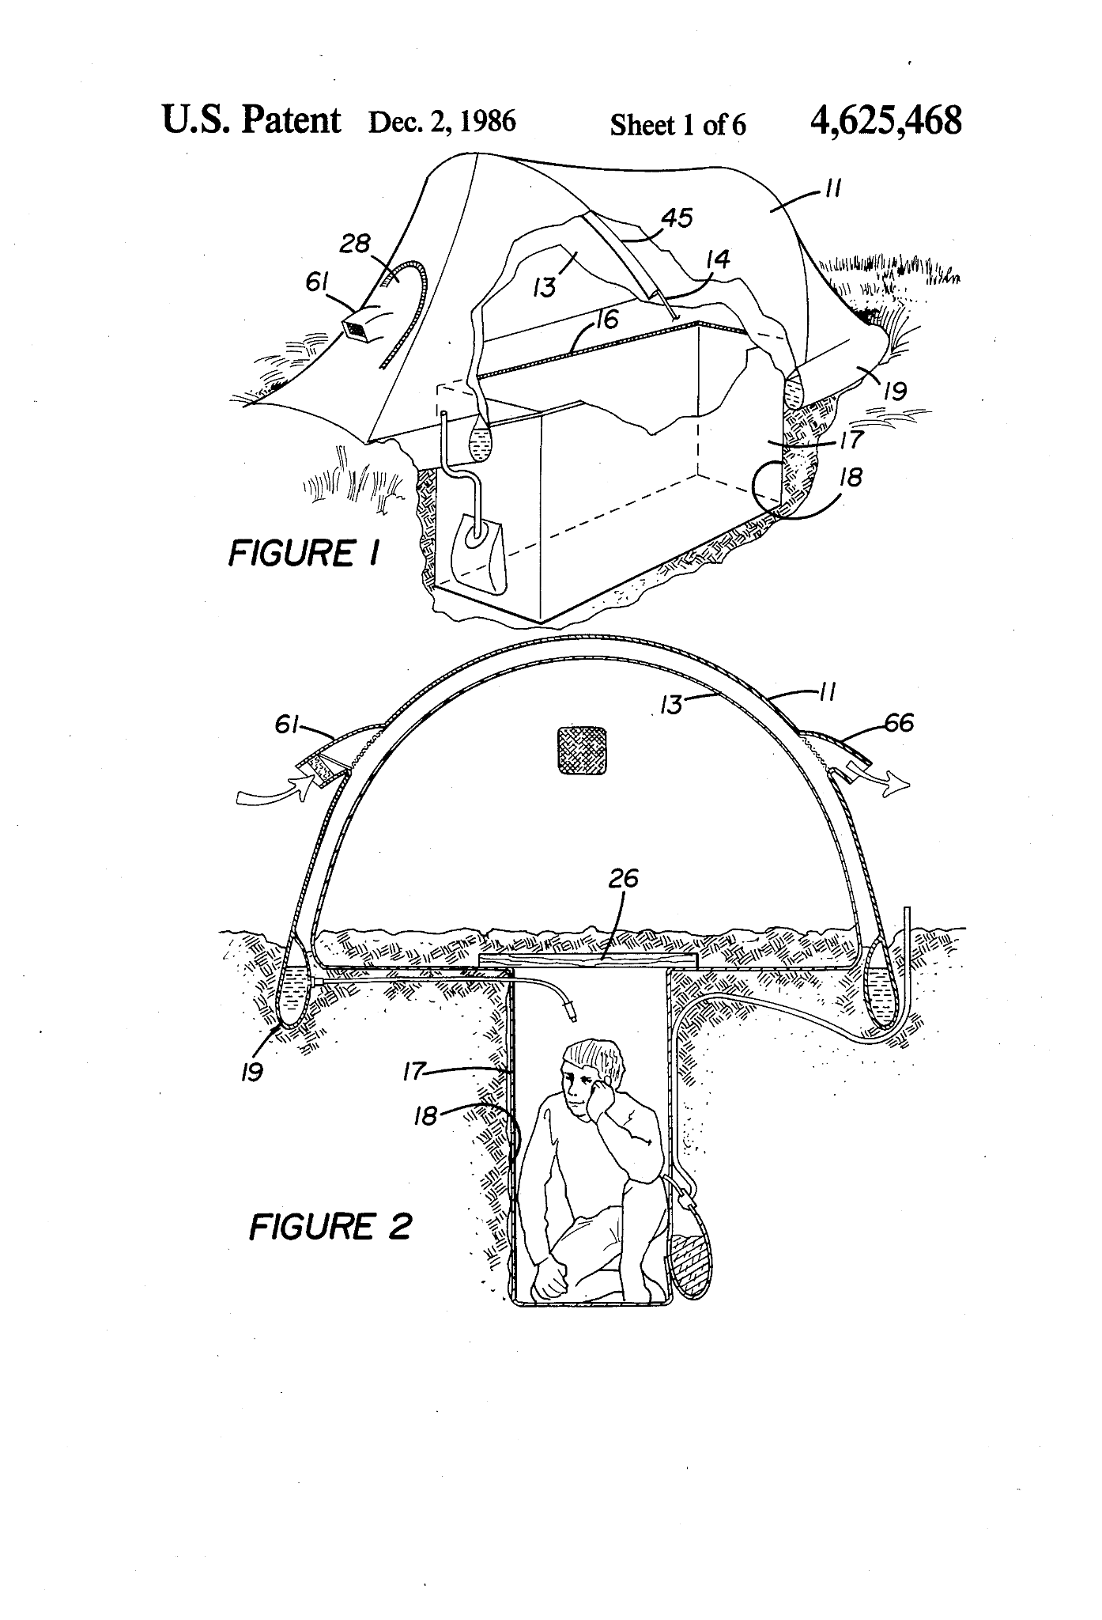
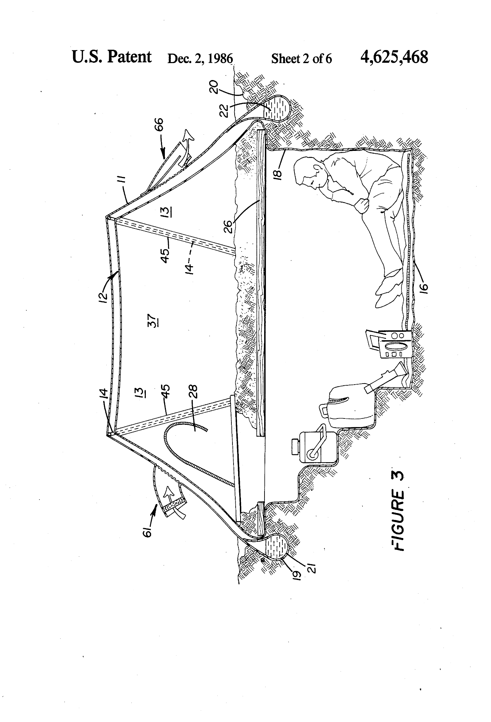
15.

Slide 69
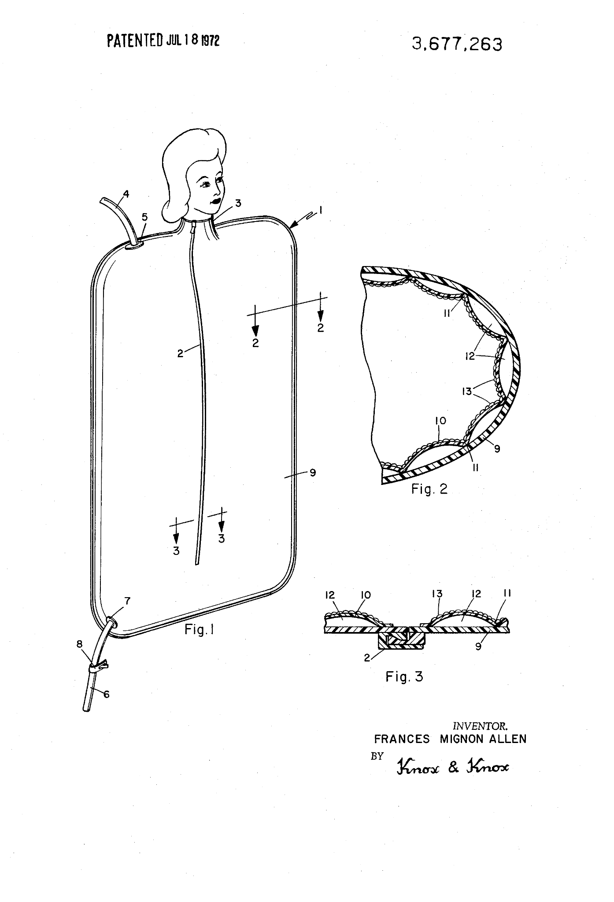
16.

Slide 70
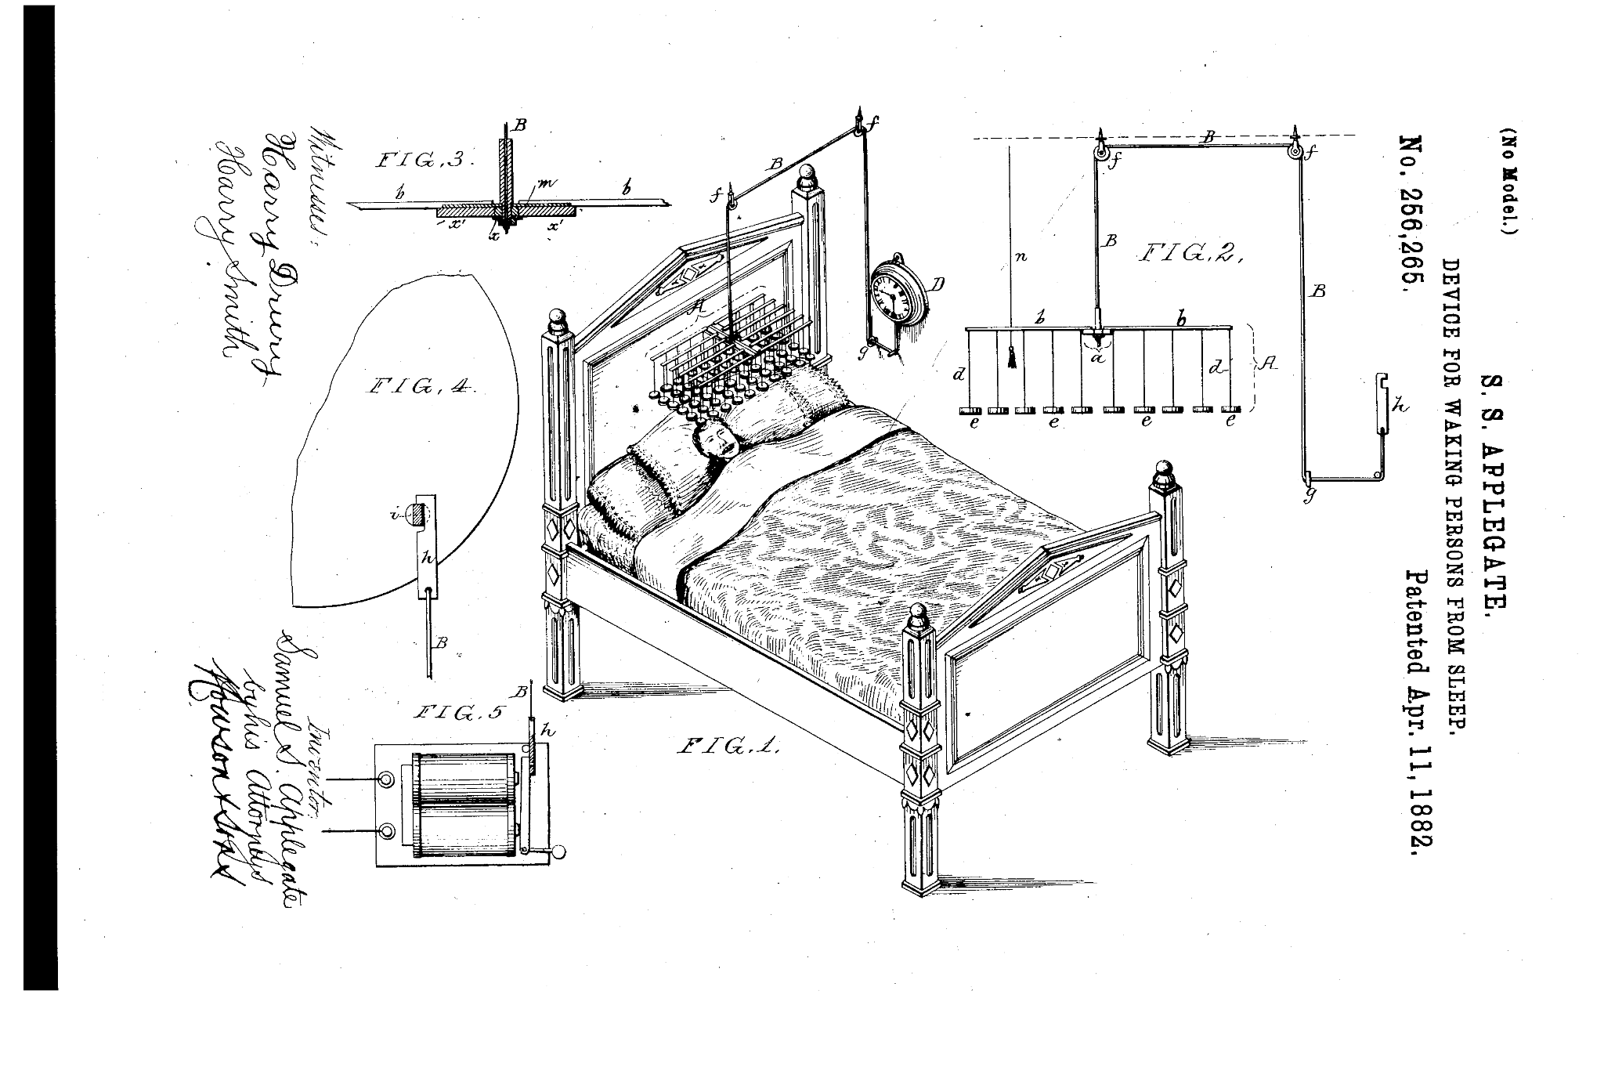
17.
Explain how it works.

Slide 71
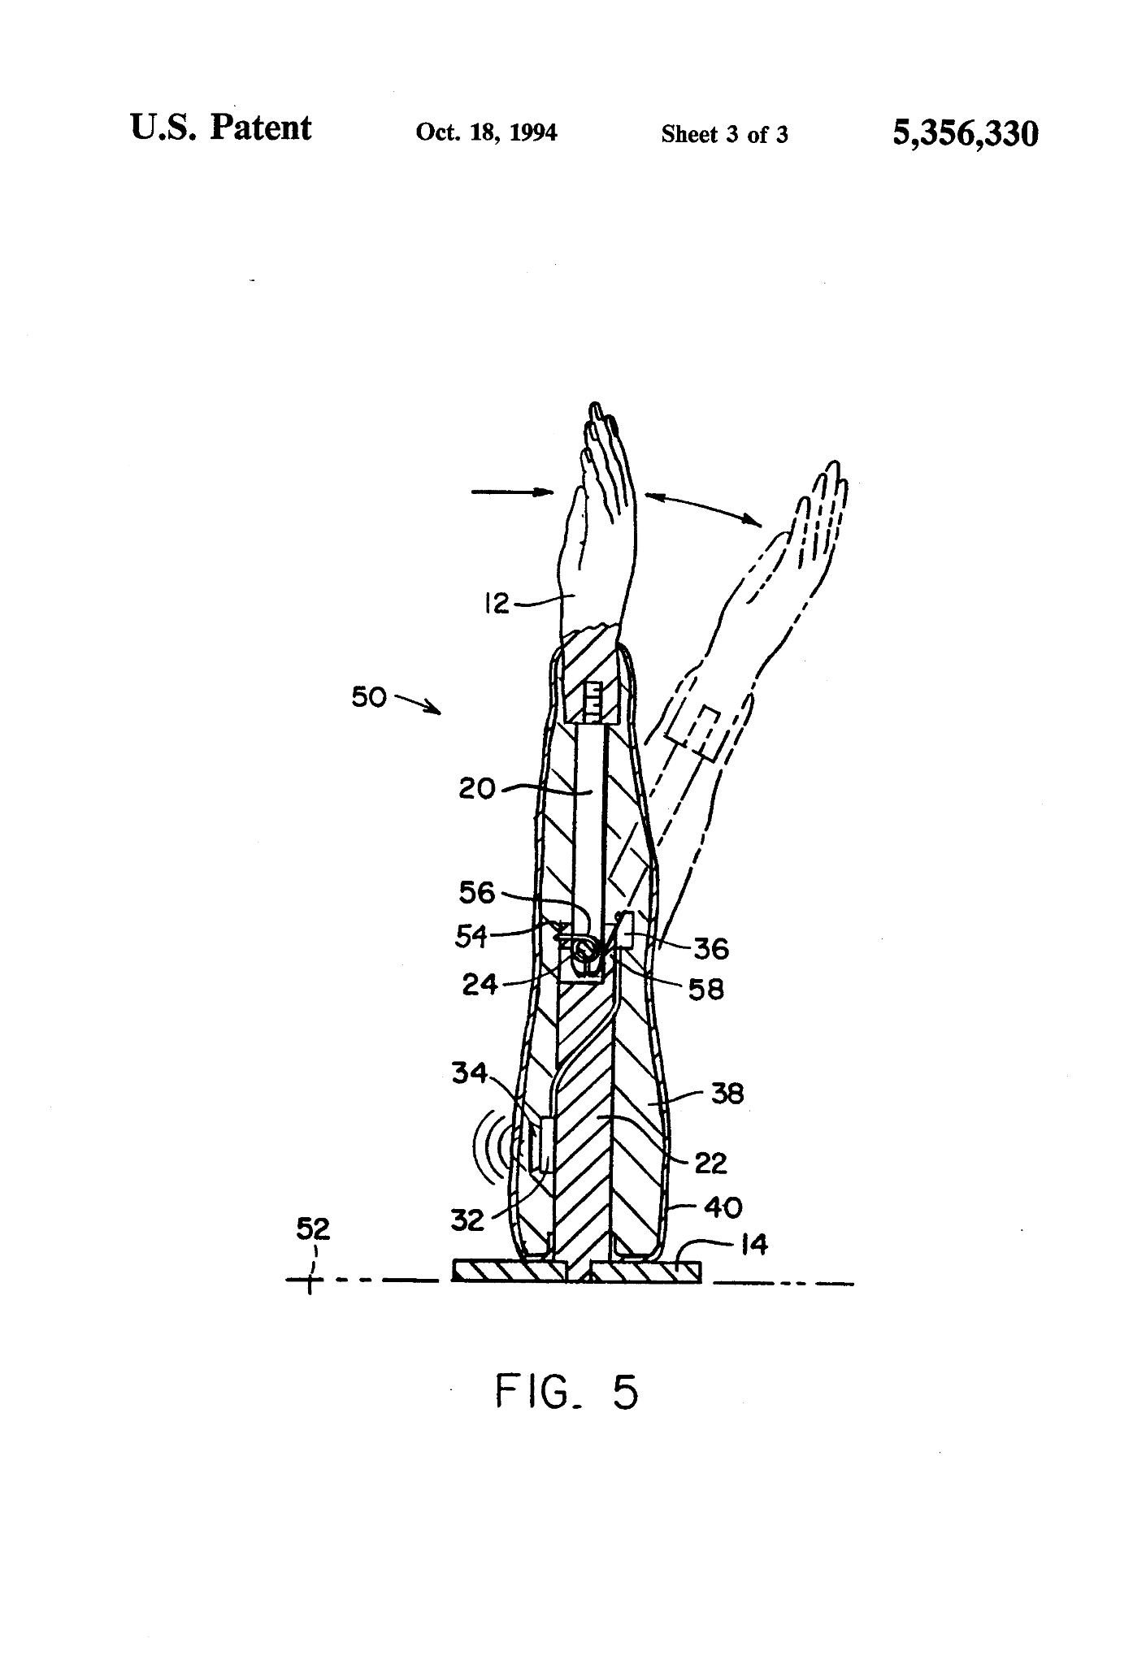
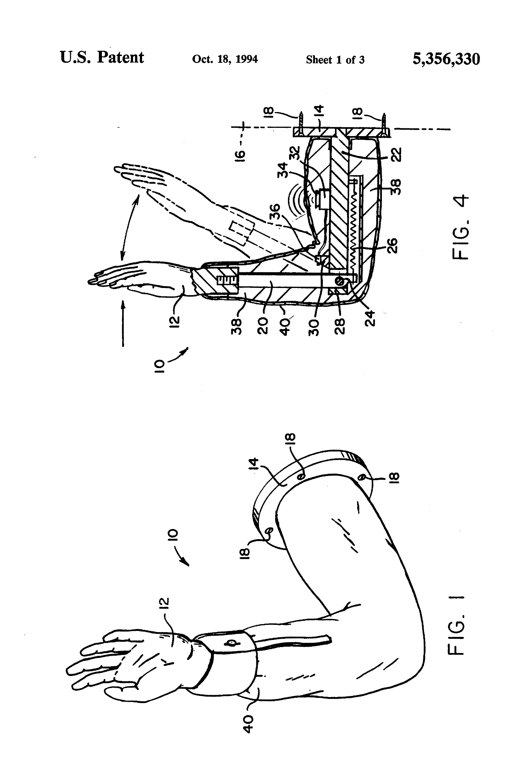
18.

Slide 72
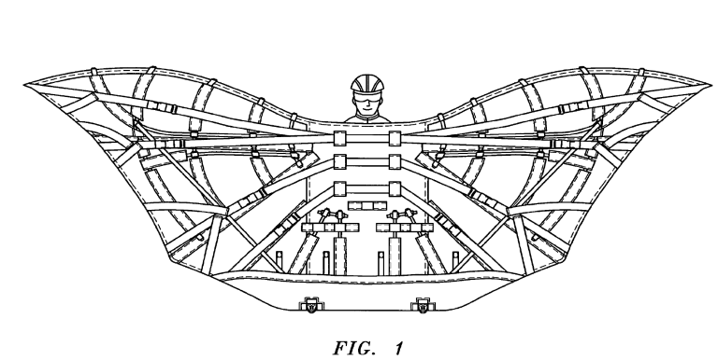
19.

Slide 73
SAFETY SLIDE

Slide 74
14.Apparatus for facilitating the birth of a child via centrifugal force

Slide 75
15.Temporary/portable nuclear fallout shelter

Slide 76
16. Portable bathing capsule

Slide 77
17. Drops the frame of blocks onto the person’s face

Slide 78
18. Machine for simulating a “high five”

Slide 79
19. Human powered flying suit

Slide 80
ROUND 4
BOOSTER
● Pounce Only(+10/0) - Pounce should have the full answer. No part pouncing, unless otherwise specified. 10 points for correct answer.
● The theme contributes as clues for the last question.
Bonus points will be awarded at the end of the round as follows:-
No. of Questions answered(excluding the last question)x10
*Bonus will only be awarded if the last question is answered correctly.

Slide 81
20.
On 18th May 2003, voters in Belgium went to the polls. The voting was done digitally(memory used was in binary) on computers in many municipalities. Election officers detected a problem with results from the municipality of Schaerbeek when the counting was being done, Maria Vindevogal, with 4610 votes, had received more votes than was possible. After a manual recount, they found that Maria had been cast only 514 votes making the initial tally an excess of 4096 votes. After running multiple checks, the computer experts concluded that some soft error(due to reasons unknown) had to be at the heart of the problem.
What soft error caused the miscount?

Slide 82
SAFETY SLIDE

Slide 83
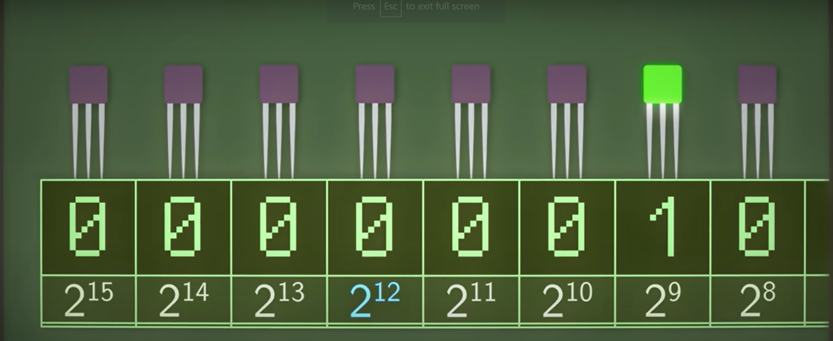
Bit-flip
converting 0 in 13th bit in the memory to a 1

Slide 84
21
Around the 1970s, Intel reported strange errors in their DRAMs. 1s would spontaneously flip to 0s with no apparent cause. The problem was found to be in the ceramic packaging of the chips which happened to have radioactive elements. 1s and 0s in the hardware represented by the absence and presence of electrons respectively were vulnerable to ionising radiation and thus alpha particles from radioactive elements knocked out electrons switching 0s to 1s. This problem however did not exist in the early days of digital computers (primarily because of their bulky design), the problem is very closely related to an important revolution in the digital electronics industry.
What revolution is being talked about here?

Slide 85
SAFETY SLIDE

Slide 86
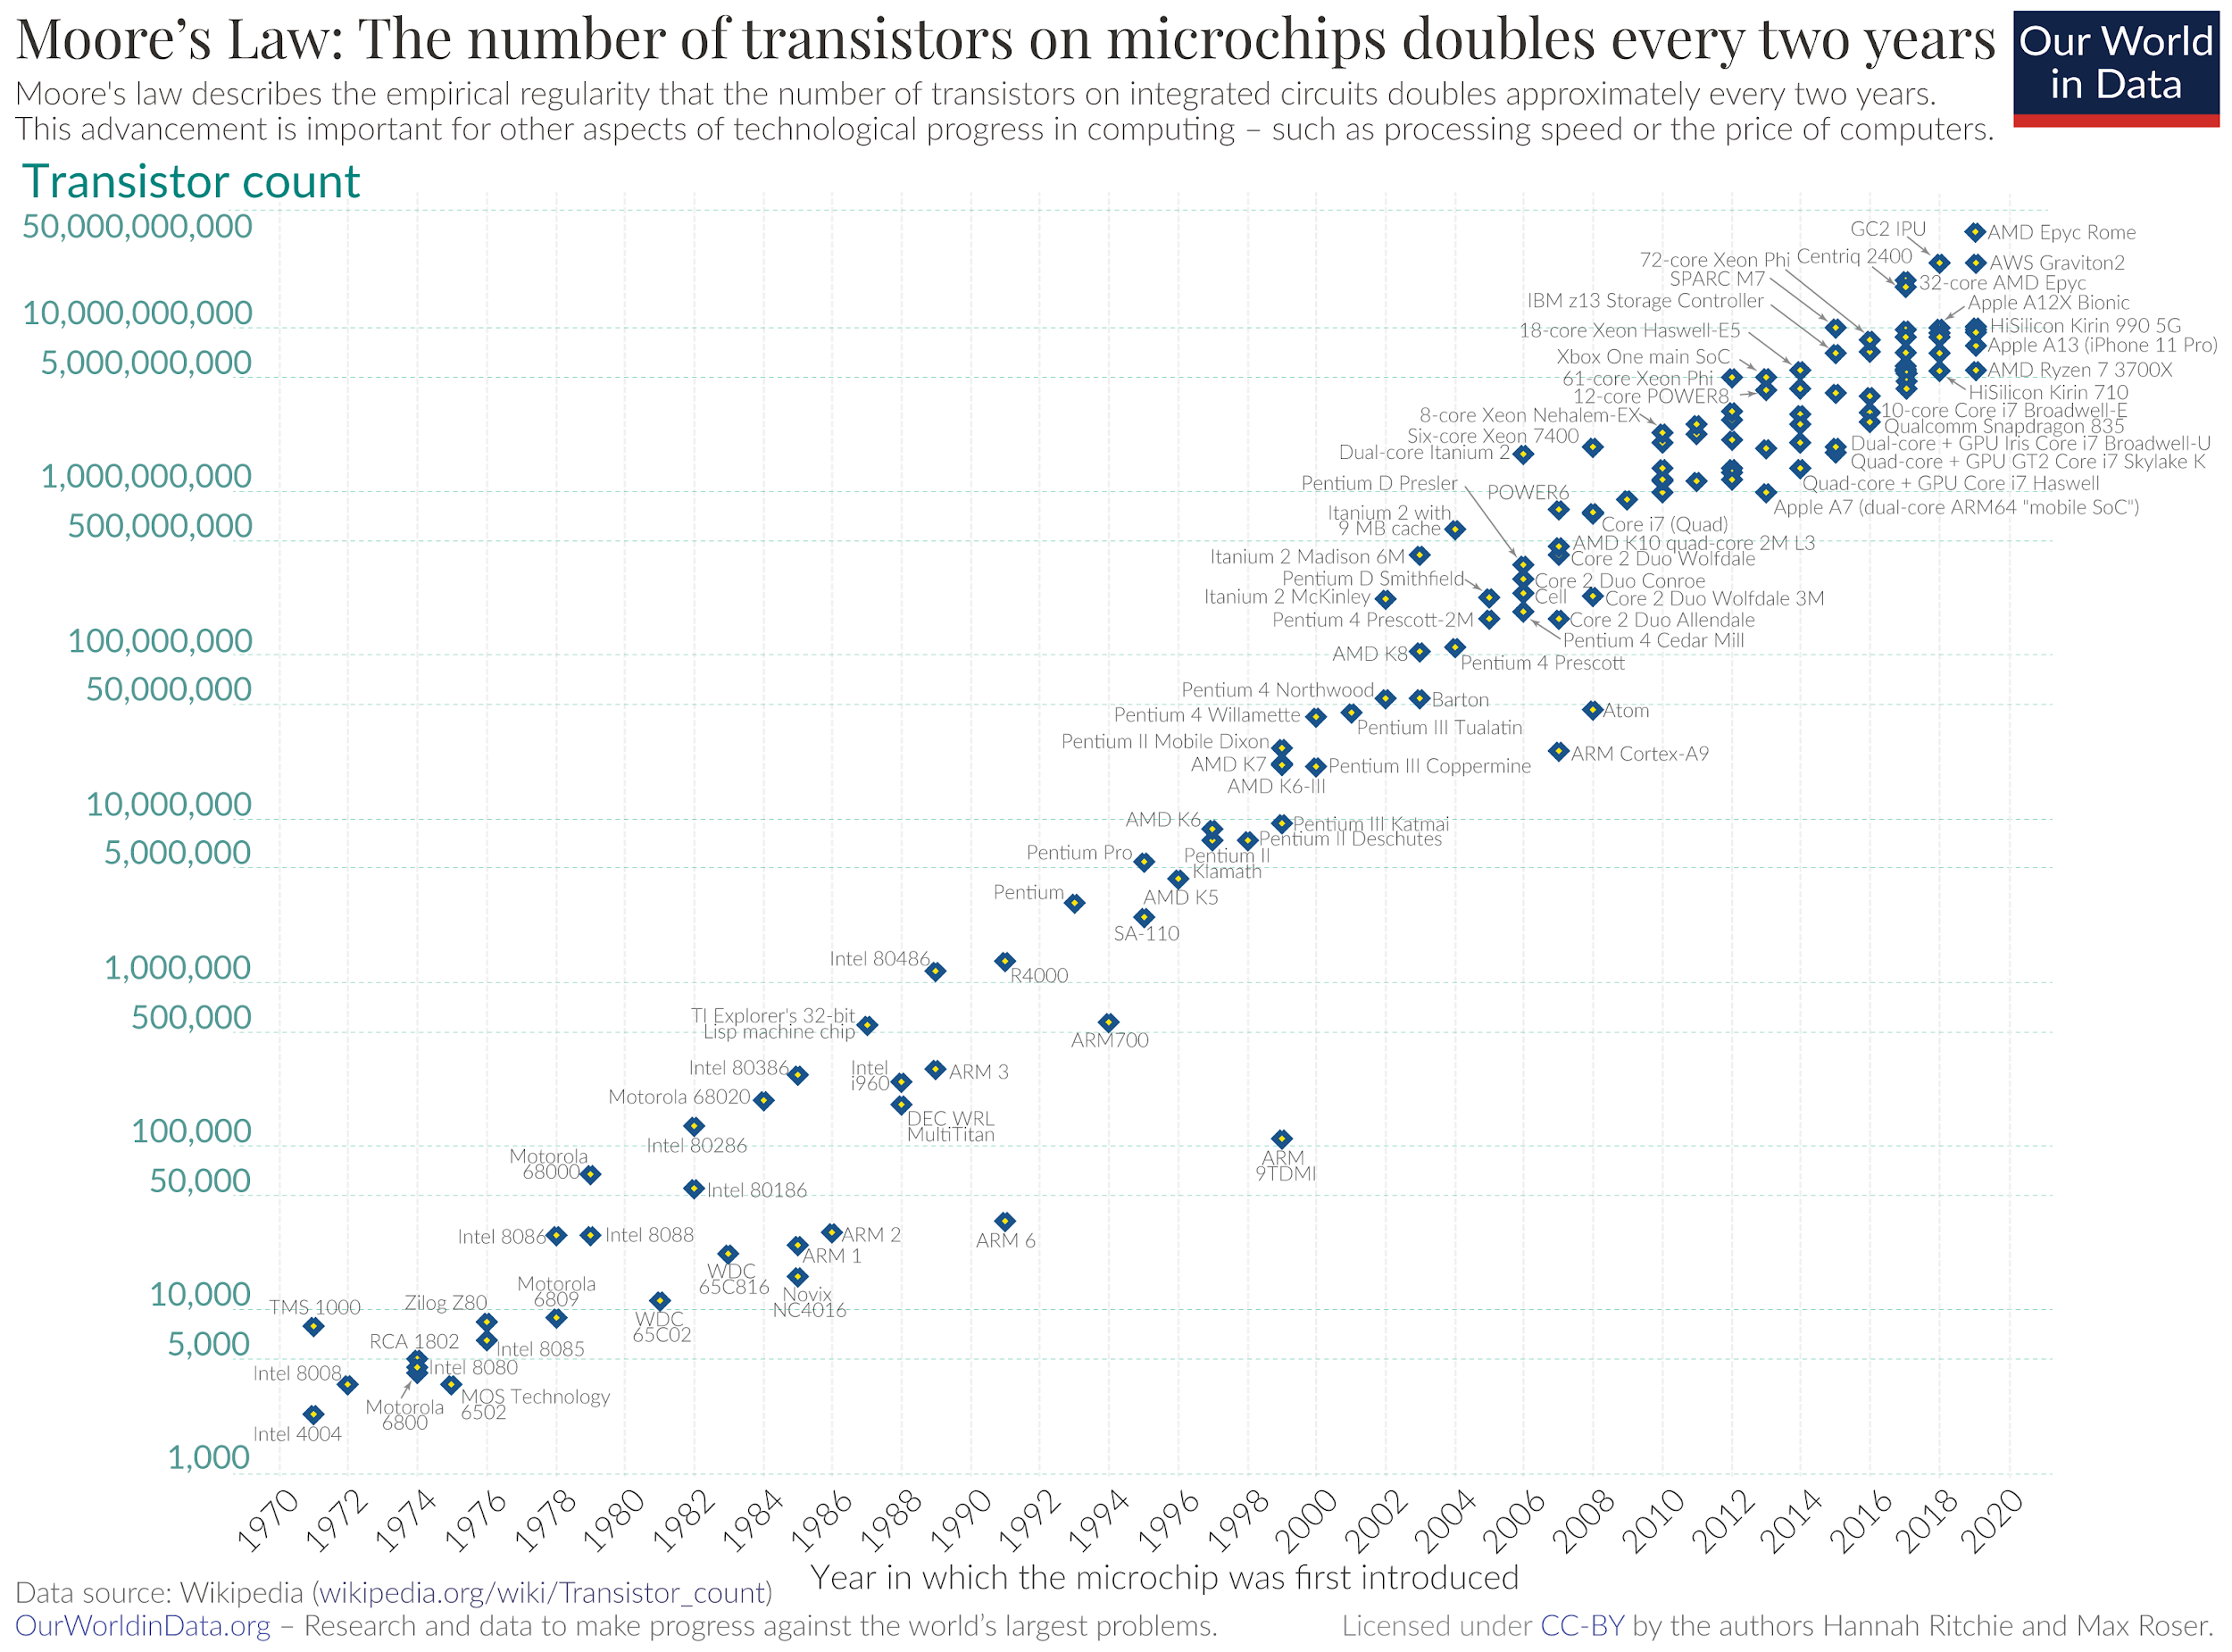
Mini-transistor revolution
Transistors started getting smaller therefore becoming more vulnerable to radiation

Slide 87
22
Subsequent efforts were made to eliminate radioactive elements from the packaging materials to prevent bit-flipping which were successful. However, numerous yet rare software glitches similar to that of the Belgian 2003 elections have ever since been reported, for example, malfunction in airplane computers, glitches in digital games resulting in unusual high-scores, etc.
The only possible explanation for such glitches are X whose discovery won Victor Hess the 1936 Nobel Prize in Physics.
ID X.

Slide 88
SAFETY SLIDE

Slide 89
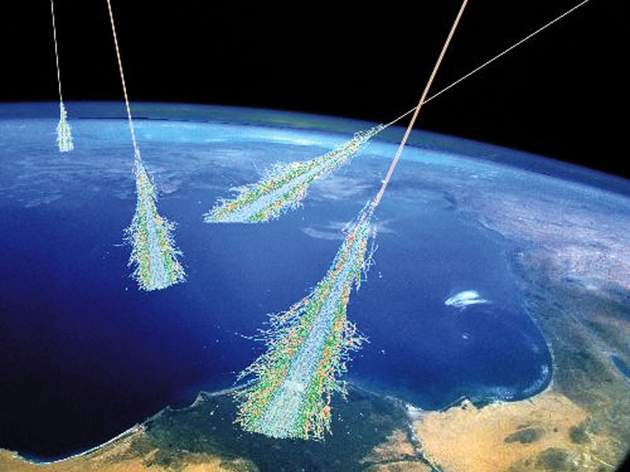
Cosmic Rays

Slide 90
ROUND 5
IB REVERSE
● Infinite Bounce (+10/0) - First question directed to Team 1 -bouncing backwards. 10 points for correct answer, no negatives - Feel free to take guesses.
● Pounce (+10/-5) - Pounce should have the full answer. No part pouncing, unless otherwise specified. 10 points for correct answer, -5 for wrong/incomplete answer.
● Directed to the team preceding the team which answered previously.

Slide 91
23
The following is a list of recorded sightings of “guest stars”:-
185- Circinus constellation
1006- Lupus constellation
1572- Cassiopeia constellation
1604-Ophiuchus constellation
1987-Dorado constellation
*not an exhaustive list
What phenomenon is being talked about?

Slide 92
SAFETY SLIDE

Slide 93
Naked eye Supernova Sightings.

Slide 94
24
Storax Sedan was a shallow underground nuclear test conducted in Nevada National Security Site in 1962, as part of Operation Plowshare, a program to investigate the use of nuclear weapons for mining, cratering, and other civilian purposes. The radioactive fallout from the test contaminated more US residents than any other nuclear test.
In 2005, Ellen Tauscher, a Democratic member of the U.S. House of Representatives from California, used Sedan as an example of a test which produced a considerable amount of radioactive fallout while giving congressional testimony on the containment of debris from nuclear testing.
However, her statement led to international uproar and temporarily dulled international relations What was the issue?

Slide 95
SAFETY SLIDE

Slide 96
"Sedan" was incorrectly transcribed as "Sudan" in the Congressional Record.

Slide 97
25
Baker was a nuclear test conducted by the US in 1946 to evaluate the effect atomic weapons had on warships at sea. The Navy initially attempted to decontaminate many of the surviving ships from the Baker test by ordering the sailors to merely mop the deck, but since the primary contaminant after the explosion was plutonium which the Navy’s geiger counters failed to register, volunteers were put at risk. Dr. Stafford Warren recognised and demonstrated the threat to the Navy by pulling a fish out of the ocean and throwing it on a photographic plate.
Why did this convince the Navy to stop the cleanup?

Slide 98
SAFETY SLIDE

Slide 99
The image is an autoradiograph- the fish took its own X-ray

Slide 100
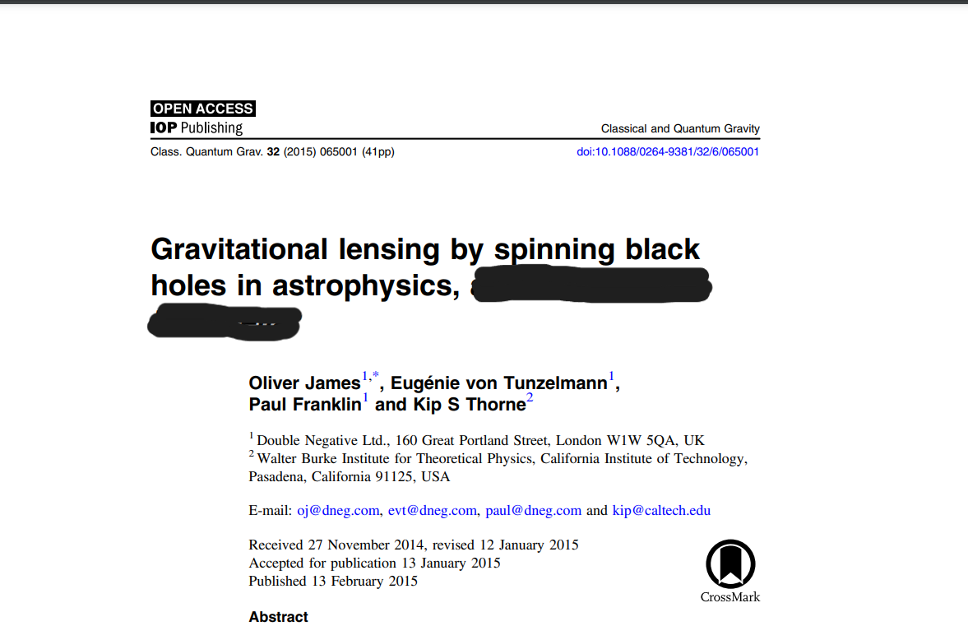
26
Paul Franklin won his 2nd Academy award for Best Achievement in Visual Effects in 2015.
What is Paul Franklin’s contribution to this paper?

Slide 101
SAFETY SLIDE

Slide 102
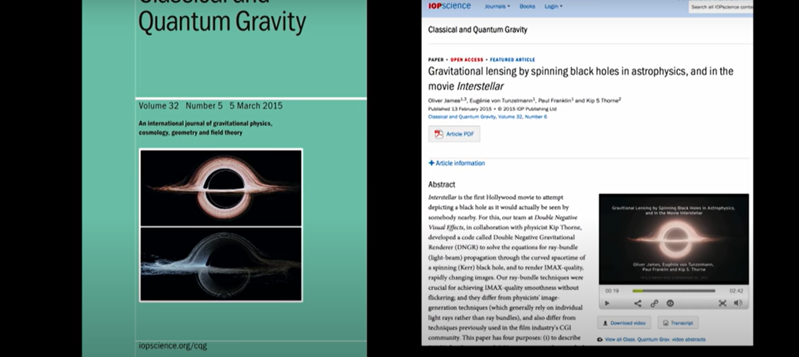
Creating the Interstellar Black hole simulation

Slide 103
27
Three physicists were working on a method to make glass tougher and more resilient to cracking. They struck upon an ingenious method to do so, inspired by the structure of tooth enamel, mother of pearl, and the shell of mollusk, all of which are thousands of times tougher than the material they are made up of. One could say that they were influenced by Kelly Clarkson’s most popular song.
What was their method?

Slide 104
SAFETY SLIDE

Slide 105
By introducing cracks in the structure

Slide 106
28
The construction of the Citicorp Center, a 59-storey skyscraper in NY City faced various challenges. Circumstances meant that the skyscraper could collapse under its own weight above a certain threshold. Chief Structural engineer William LeMessurier designed V-shaped chaperons to give the structure an exoskeleton which at the same time made it much lighter, now vulnerable to NY City’s dangerous strong winds. To counter this LeMessier went for another state-of-the-art solution X which would prevent the structure from toppling over.
X is commonly used in bridges to prevent large vibrations due to resonance with pedestrian loads.
ID X.

Slide 107
SAFETY SLIDE

Slide 108
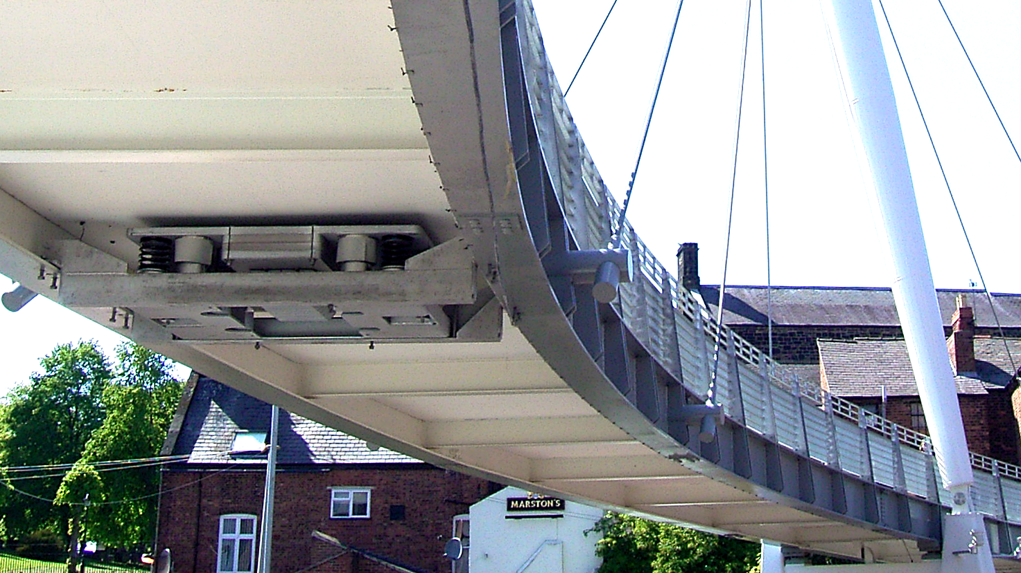
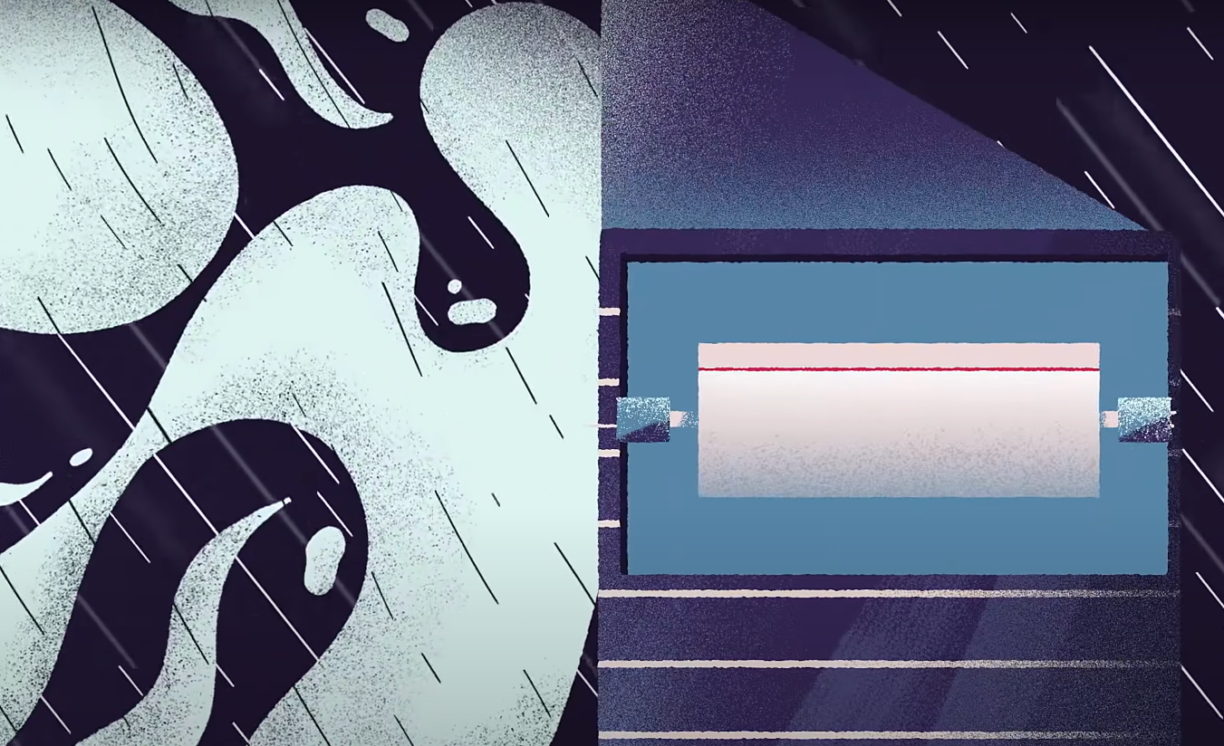
Tuned Mass Dampers

Slide 109
29
The Fosbury flop revolutionized the high jump event forever after Dick Fosbury used his new ‘back first’ technique to win the high jump gold in the 1968 Olympics.
Unlike traditional jumping methods which solely rely on the brute force generated by the athlete, hurling his/her entire body above the bar, the Fosbury flop allows an athlete to clear higher height bars while applying the same amount of force as the traditional methods by exploiting a simple property of the Center of Mass.
What property of the Center of Mass is being talked about here?

Slide 110
SAFETY SLIDE

Slide 111
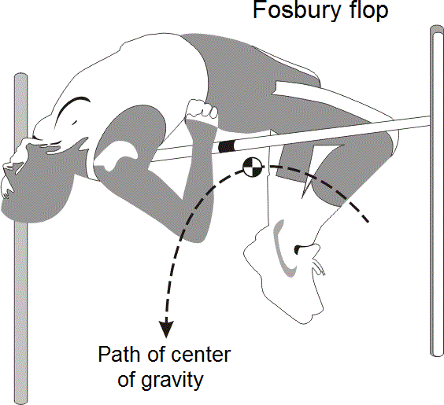
Position of the Centre of Mass can be outside the body.
In the Fosbury flop, the CoM is below the bar while the body of the athlete crosses over over.

Slide 112
30
During a televised hearing on February 11, Feynman demonstrated ______ using a glass of cold water and a piece of rubber, for which he received media attention.
In an interview with CNN, later, he explains the relevance of that demonstration with respect to the accident. Play clip 6:58-8:06 mins.
What phenomenon did Feynman demonstrate at the public hearing on Feb 11?

Slide 113
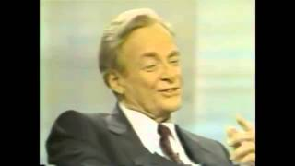
Play video

Slide 114
SAFETY SLIDE

Slide 115
Loss of elasticity in rubber.

Slide 116
31
The Human Interference Task Force was convened by the US Department of Defense to devise methods that ensured that Humans could avoid waste Nuclear fuel storage areas.
The panel reasoned that since few people can read texts that are only 1,000 years old, written warnings guaranteed to be understood by future humanity could be difficult to create.
The answer may lie in “nuclear semiotics” – future-proof signs.
The team came up with an ingenious solution, relying on an animal that is deeply embedded into several cultures and mythologies across the world for millennia.
What animal did they choose, and what was their method?

Slide 117
SAFETY SLIDE

Slide 118
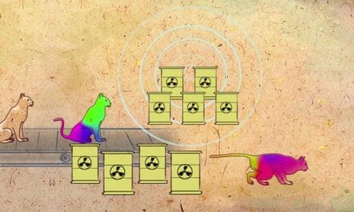
Breeding cats that react with discoloration of the skin when exposed to radiation. A legend, passed on through the millennia, would trigger a response in humans to get out as soon as possible.

Slide 119
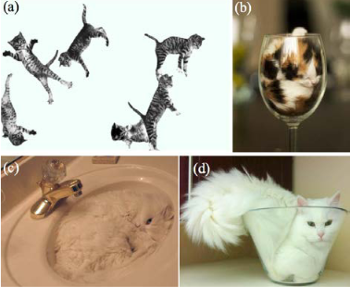
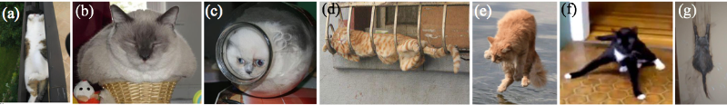
32
Here are some images from M.A. Faradin’s paper. What is the paper’s objective?

Slide 120
SAFETY SLIDE

Slide 121
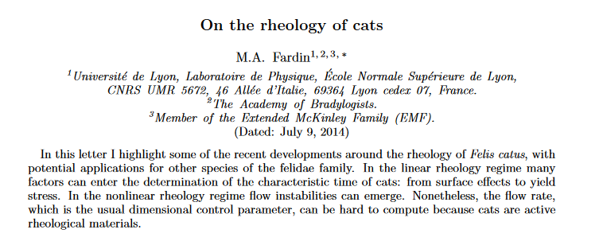
Determining if cats can behave as solids and liquids simultaneously, and under different conditions

